Slide 1
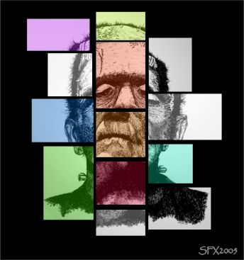
Frankenstein
by
Mary Shelley

Slide 2
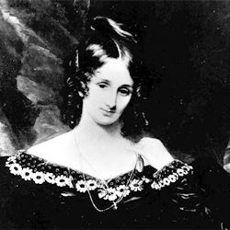
Background
Daughter of two intellectual radicals:
Mary Wollstonecraft: early women’s rights activist
William Godwin: political philosopher and novelist

Slide 3
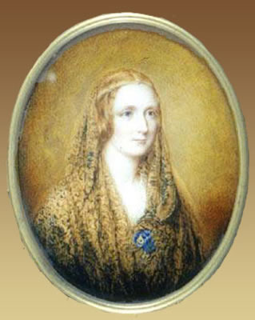
Background continued…
Ran away with Percy Shelley when she was 16
Percy was married at the time
He and Mary married when she was18 after the death off his legal wife
Percy Shelley was a well-known literary figure in England→ Mary listened intently to his intellectual conversations with others

Slide 4
The Novel
Mary Shelley did not attach her name to the novel, so many people assumed her husband wrote it.
The story was inspired by a trip to the Swiss Alps when she, Percy, and Lord Byron challenged each other to tell ghost stories.
She told of a dream she had where her dead child was brought back to life with the heat of a fire
She wrote the novel in a year, and it was published when she was 19.

Slide 5
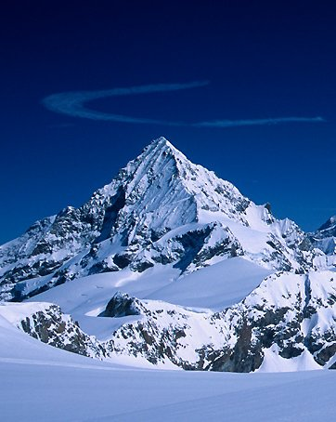
Setting
Switzerland
Germany
The arctic

Slide 6
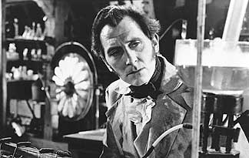
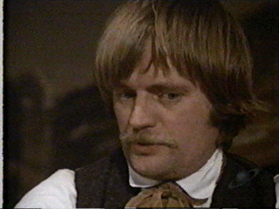
Main Characters
Victor Frankenstein: fascinated with science
Henry Clerval: Victor’s best friend

Slide 7
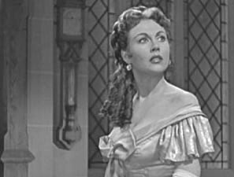
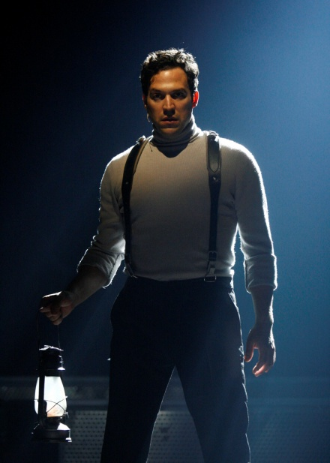
Main Characters
Elizabeth: Victor’s adopted sister and wife
Robert Walton: arctic explorer who rescues Victor

Slide 8
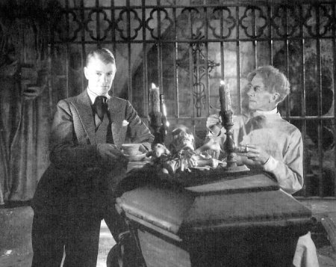
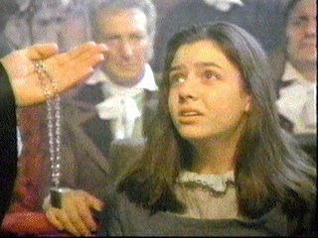
Main Characters
William and Ernest: Victor’s younger brothers
Justine Moritz: live-in servant

Slide 9
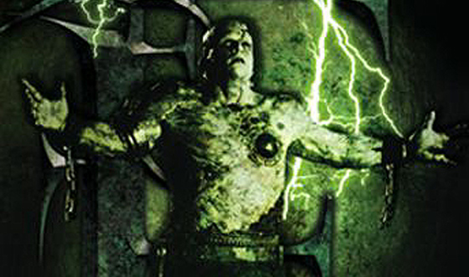
Main Characters
The monster: created from inanimate body parts by Victor

Slide 10
Frame Story
The first part you read is the letters. This is actually the END of the story, but you read it FIRST.
The second part you read is Victor Frankenstein's story. It’s the BEGINNING of the story, but you read it SECOND.
The third part you read is the monster’s tale. It’s the middle of the story, but you read it LAST.

Slide 11
Gothic Literataure
Watch for elements of Gothic literature (this is the type of lit that inspired Hawthorne and Poe).
Eerie and supernatural events
Melancholy atmosphere
Reflects wild, unpredictable aspects of nature
Gloomy, desolate, and harsh settings

Slide 12
Romantic Literature (not like a trashy romance novel)
Emphasis on imagination and emotion, individual passion and inspiration
A turn to the past or an inner dream world that is thought to be more perfect
and magical than the current world (industrial age)
Belief in individual liberty; rebellious attitude against tyranny
Concerned with common people
Nature should be untamed

Slide 13
Themes
Consequences of irresponsibility in the pursuit of knowledge
Consequences of pride
Consequences of society’s rejection of someone who is unattractive
Destructive power of revenge
Parent-child conflicts
Sympathy

