Slide 1
MS English
“The greatest power on earth is the magnificent power we all of us possess… the power of the human brain!”
– Charles Xavier, X-Men
Teacher Info
Grading
Mrs. Doke
E-mail: mdoke@eupschools.org
Phone: 906-492-3353 Ext. 1013
Class Website: mrsdokes.weebly.com
What’s in a grade?
I use a points based system. That means that I will assign however many points I feel that an assignment is worth. The more important and harder the assignment, the more points that it will be worth! Your grade will be a combination of the following:
Tests
Quizzes
Projects
Homework
In Class Assignments
Participation & Behavior
Extra Credit
WELCOME
This is your yearly English class! Be prepared for reading and writing every day! Everyone has their own unique abilities and therefore you will be held to your own standard from me. Just remember to do your best!
Expectations
Classroom Behavior
Be on time!
Be prepared!
Be respectful to EVERYONE!
No drama!
Materials
Your Book
Notebook & Pen
Folder with any handouts
Computer
Homework or extended assignments
NO CELL PHONES!
Suggested:
Flash drive
Water bottle
Missing Work
LATE WORK
My usual practice is that for each school day that an assignment is late you lose 10% of the grade. For some larger assignments that you are given the deadline weeks ahead of time I may bump that up to 25% gone for each day it is late.
You will be allowed three “Redo” forms per semester. This allows you to turn in three late assignments per semester without losing points for it being late. Another option with this form is that if you already turned an assignment in on time but you want to try and earn a better grade you may edit the assignment and resubmit it using this form. Redo forms can be found in the basket labeled, “Redo”.

Slide 2
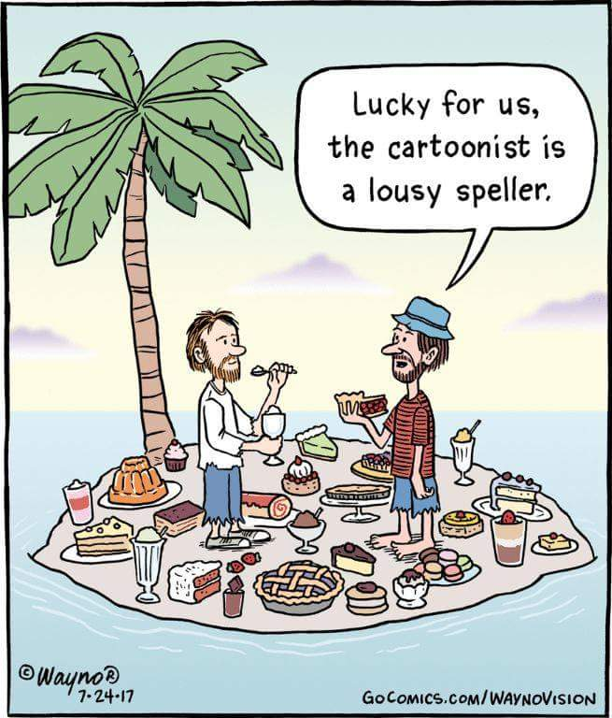
New Policy!
Other Policies
In the past we have had issues with students falling behind with their homework and assignments until it snowballs and gets out of control. Poor grades don’t seem to motivate you, detentions didn’t motivate you, and the redo forms are only good three times. So this year I have a new policy! If I see that you are missing an assignment or have an extremely low grade on an assignment in my gradebook you are going to email you parent/guardian (with a copy to me as well) explaining to them what is low or missing and why. This way they will not seem shocked when it comes to report cards or conferences if you have a low grade due to missing assignments.
Cheating & Plagiarism
Just don’t do it. If I discover that you have used someone else’s work as your own on purpose you will get an automatic zero for that assignment, no matter how small it may be. If you have done so by accident (say, by using a quote and not citing it correctly) you will have one chance to redo the assignment.
Leaving The Classroom
If you have to leave the classroom because you are not prepared, I will mark you as tardy. If you have to use the restroom, just tell me. If it becomes an every day thing I’m going to get suspicious and suspend these privileges!
Possible Texts
Listening to Music
When I give you class time to work on assignments you may listen to music on headphones if it helps you focus. This must be done through your laptop, no cell phones. I should not be able to hear it from across the room and it should not distract you or others from work. I can tell you to turn your music off at any time if I feel it is distracting… or just because I said so.
As always I will start with a list of novels that are available from our class sets for reading this year, but it is up for debate and open to suggestion:
And Then There Were None
Mrs. Frisby and the Rats of NIMH
The Lion, The Witch, and The Wardrobe
The One and Only Ivan
The Raven and other Edgar Allan Poe Works
The Time Machine
Treasure Island
Witness
Blind Date With A Book
Newer YA Book
Extra Credit
Free Time
If by some miracle you have completed all of your work for me to the highest expectations you have some options: 1. Extra credit. 2. Work that you have for another class. 3. Read a book. 4. Creative activities. No sleeping or distracting others!
Possible Projects
Comic Strips
Compare and Contrast Paper
Creative Writing
Literary Art
Newsletter
Novel Essays
Opinion Paper
Personal Narratives
Research Papers
Reviews
I have read this!
STUDENT DATE
PARENT EMAIL ADDRESS

